Slide 1
Using JDeveloper

Slide 2
Objectives
After completing this appendix, you should be able to do the following:
  List the key features of Oracle JDeveloper
  Create a database connection in JDeveloper
  Manage database objects in Jdeveloper
  Use JDeveloper to execute SQL Commands
  Create and run PL/SQL Program Units
Notes:
Oracle Database 11g: PL/SQL Fundamentals E - <number>
Objectives
In this appendix, you are introduced to the tool JDeveloper. You learn how to use JDeveloper for your database development tasks.

Slide 3
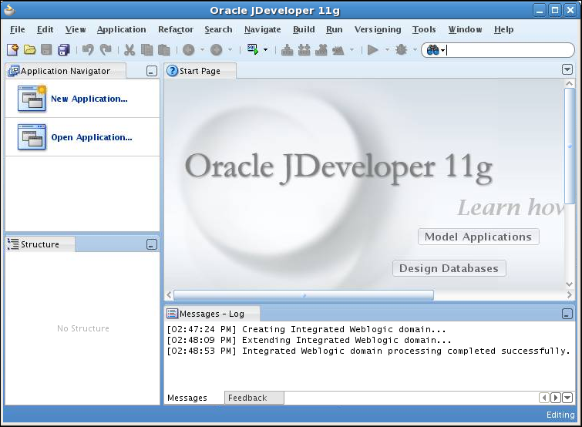
Oracle JDeveloper
Notes:
Oracle Database 11g: PL/SQL Fundamentals E - <number>
Oracle JDeveloper
Oracle JDeveloper is an integrated development environment (IDE) for developing and deploying Java applications and Web services. It supports every stage of the software development life cycle (SDLC) from modeling to deploying. It has the features to use the latest industry standards for Java, XML, and SQL while developing an application.
Oracle JDeveloper 11g initiates a new approach to J2EE development with features that enable visual and declarative development. This innovative approach makes J2EE development simple and efficient.

Slide 4
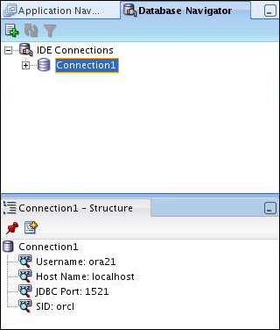
Database Navigator
Notes:
Database Navigator
Using Oracle JDeveloper, you can store the information necessary to connect to a database in an object called “connection.” A connection is stored as part of the IDE settings, and can be exported and imported for easy sharing among groups of users. A connection serves several purposes from browsing the database and building applications, all the way through to deployment.

Slide 5

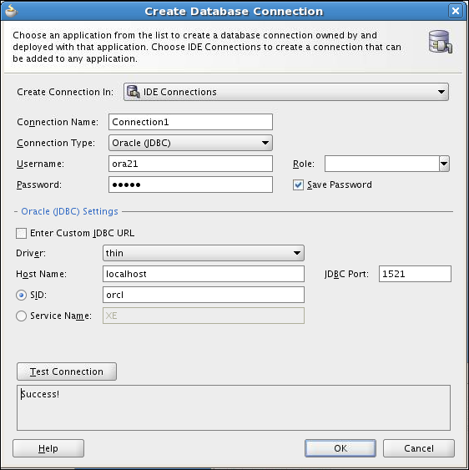
Creating a Connection
Click the New Connection icon in the Database Navigator.
1
2
In the Create Database Connection window, enter the username, password and the SID.
3
Test the connection.
4
Click OK.
Notes:
Creating a Connection
A connection is an object that specifies the necessary information for connecting to a specific database as a specific user of that database. You can create and test connections for multiple databases and for multiple schemas.
To create a database connection, perform the following steps:
1. Click the New Connection icon in the Database Navigator.
2. In the Create Database Connection window, enter the connection name. Enter the username and password of the schema that you want to connect to. Enter the SID of the database that you want to connect to.
3. Click Test to ensure that the connection has been set correctly.
4. Click OK.

Slide 6
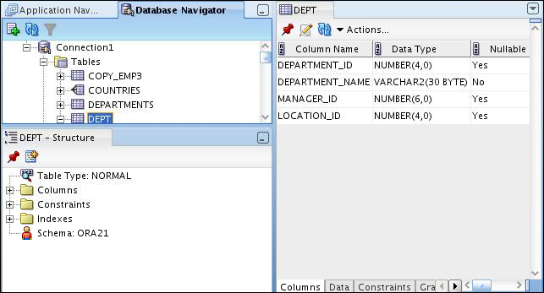
Browsing Database Objects
Use the Database Navigator to:
  Browse through many objects in a database schema
  Review the definitions of objects at a glance
Notes:
Browsing Database Objects
After you create a database connection, you can use the Database Navigator to browse through many objects in a database schema including tables, views, indexes, packages, procedures, triggers, and types.
You can object definitions broken into tabs of information that is pulled out of the data dictionary. For example, if you select a table in the Navigator, details about columns, constraints, grants, statistics, triggers, and so on are displayed on an easy-to-read tabbed page.

Slide 7
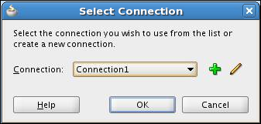

Executing SQL Statements
1
2
3
Notes:
Executing SQL Statements
To execute a SQL statement, perform the following steps:
Click the Open SQL Worksheet icon.
Select the connection.
Execute the SQL command by clicking:
The Execute statement button or by pressing F9. The output is as follows:
The Run Script button or by pressing F5. The output is as follows:

Slide 8
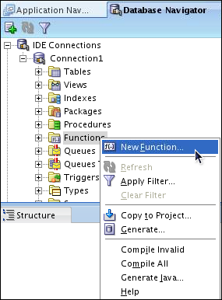
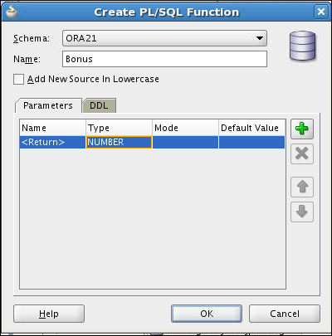
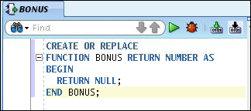
Creating Program Units
2
1
3
Skeleton of the function
Notes:
Oracle Database 11g: PL/SQL Fundamentals E - <number>
Creating Program Units
To create a PL/SQL program unit:
Select View > Database Navigator. Select and expand a database connection. Right-click a folder corresponding to the object type (Procedures, Packages, Functions). Select “New [Procedures|Packages|Functions]”.
Enter a valid name for the function, package, or procedure, and click OK.
A skeleton definition is created and opened in the Code Editor. You can then edit the subprogram to suit your need.

Slide 9
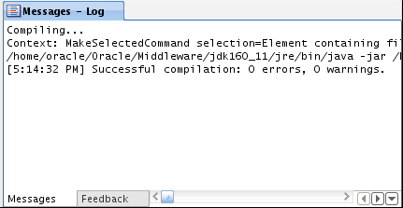
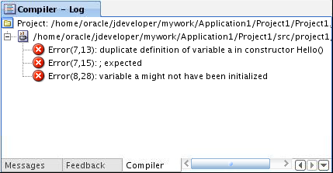
Compiling
Compilation with errors
Compilation without errors
Notes:
Compiling
After editing the skeleton definition, you need to compile the program unit. Right-click the PL/SQL object that you need to compile in the Connection Navigator, and then select Compile. Alternatively, you can press CTRL + SHIFT + F9 to compile.

Slide 10
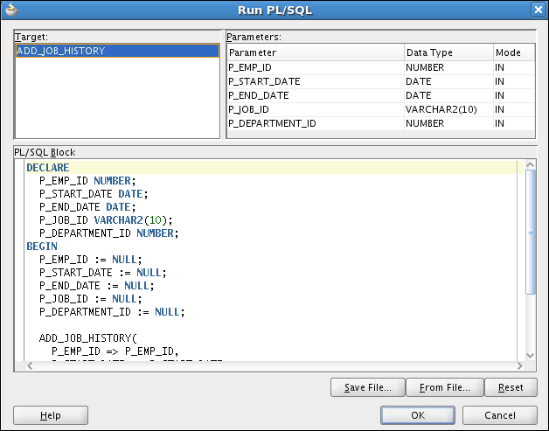
Running a Program Unit
Notes:
Running a Program Unit
To execute the program unit, right-click the object and select Run. The Run PL/SQL dialog box appears. You may need to change the NULL values with reasonable values that are passed into the program unit. After you change the values, click OK. The output is displayed in the Message-Log window.

Slide 11
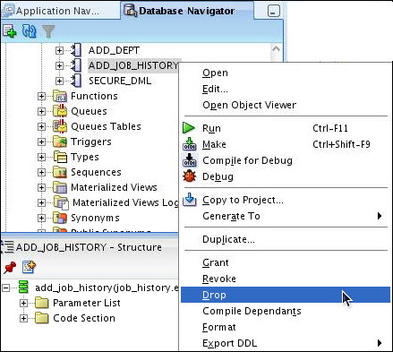
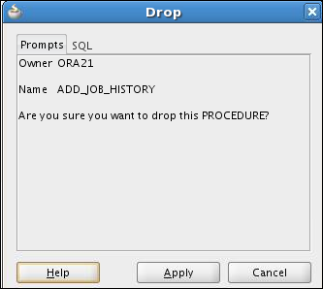
Dropping a Program Unit
1
2
Notes:
Dropping a Program Unit
To drop a program unit:
Right-click the object and select Drop.
The Drop Confirmation dialog box appears.
Click Apply.
The object is dropped from the database.

Slide 12
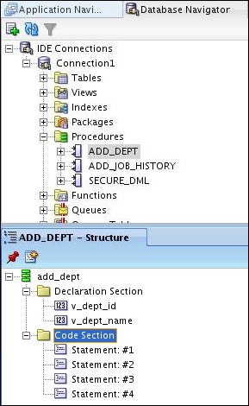
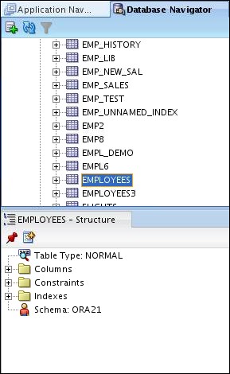
Structure Window
Notes:
Structure Window
The Structure window offers a structural view of the data in the document that is currently selected in the active window of those windows that participate in providing structure: the navigators, the editors and viewers, and the Property Inspector.
In the Structure window, you can view the document data in a variety of ways. The structures that are available for display are based on document type. For a Java file, you can view code structure, UI structure, or UI model data. For an XML file, you can view XML structure, design structure, or UI model data.
The Structure window is dynamic, tracking always the current selection of the active window (unless you freeze the window’s contents on a particular view), as is pertinent to the currently active editor. When the current selection is a node in the navigator, the default editor is assumed. To change the view on the structure for the current selection, select a different structure tab.

Slide 13
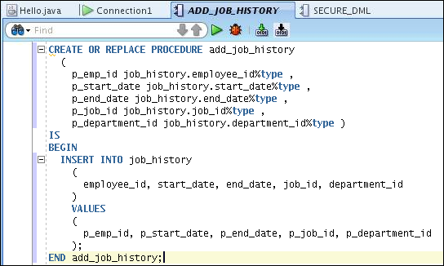
Editor Window
Notes:
Editor Window
You can view your project files all in one single editor window, you can open multiple views of the same file, or you can open multiple views of different files.
The tabs at the top of the editor window are the document tabs. Selecting a document tab gives that file focus, bringing it to the foreground of the window in the current editor.
The tabs at the bottom of the editor window for a given file are the editor tabs. Selecting an editor tab opens the file in that editor.

Slide 14
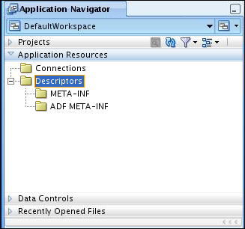
Application Navigator
Notes:
Application Navigator
Application Navigator gives you a logical view of your application and the data that it contains. Application Navigator provides an infrastructure that the different extensions can plug in to and use to organize their data and menus in a consistent, abstract manner. While Application Navigator can contain individual files (such as Java source files), it is designed to consolidate complex data. Complex data types such as entity objects, Unified Modeling Language (UML) diagrams, Enterprise JavaBeans (EJB), or Web services appear in this navigator as single nodes. The raw files that make up these abstract nodes appear in the Structure window.

Slide 15



Deploying Java Stored Procedures
Before deploying Java stored procedures, perform the following steps:
  1. Create a database connection.
  2. Create a deployment profile.
  3. Deploy the objects.
1
2
3
Notes:
Deploying Java Stored Procedures
Create a deployment profile for Java stored procedures, and then deploy the classes and, optionally, any public static methods in JDeveloper using the settings in the profile.
Deploying to the database uses the information provided in the Deployment Profile Wizard and two Oracle Database utilities:
loadjava loads the Java class containing the stored procedures to an Oracle database.
publish generates the PL/SQL call–specific wrappers for the loaded public static methods. Publishing enables the Java methods to be called as PL/SQL functions or procedures.

Slide 16
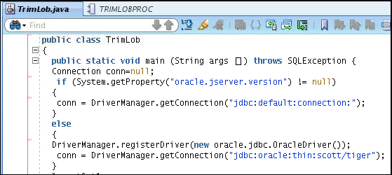
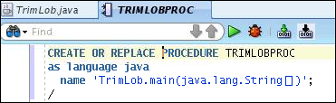
Publishing Java to PL/SQL
1
2
Notes:
Publishing Java to PL/SQL
The slide shows the Java code and illustrates how to publish the Java code in a PL/SQL procedure.

Slide 17
How Can I Learn More About JDeveloper 11g ?
Topic | Web site
Oracle JDeveloper Product Page | http://www.oracle.com/technology/products/jdev/index.html
Oracle JDeveloper 11g Tutorials | http://www.oracle.com/technology/obe/obe11jdev/11/index.html
Oracle JDeveloper 11g Product Documentation | http://www.oracle.com/technology/documentation/jdev.html
Oracle JDeveloper 11g Discussion Forum | http://forums.oracle.com/forums/forum.jspa?forumID=83

Slide 18
Summary
In this appendix, you should have learned how to use JDeveloper to do the following:
  List the key features of Oracle JDeveloper
  Create a database connection in JDeveloper
  Manage database objects in JDeveloper
  Use JDeveloper to execute SQL Commands
  Create and run PL/SQL Program Units
Notes:
Oracle Database 11g: PL/SQL Fundamentals E - <number>
Objectives
In this appendix, you are introduced to the tool JDeveloper. You learn how to use JDeveloper for your database development tasks.

